Slide 1

Your past, your present and your future

Slide 2


Slide 3
Overview
Idea
Technologies
Competitors
Costs
Team
Planification
Demo
Piloting plan

Slide 4
IDEA
What is Capsulefy?

Slide 5





Time capsule

Slide 6


Payment plans
 | Free | Premium
Price | 0 € | 11.99 €
Storage | 20 MB/user | 500 MB/capsule
Social network and email integration
Capsule scheduling | 1 year | No limit
Capsule expiration | 6 months after release | No expiration
Modular and private capsules

Slide 7
TECHNOLOGIES
What stack do we use?

Slide 8




Web app
Users and capsules
Media storage
Social network

Slide 9





Slide 10
Travis CI builds
All branches |  |  | Master
Passed | Failed | Cancelled | Passed | Failed | Cancelled
373 | 133 | 42 | 24 | 16 | 2
Total: 548 |  |  | Total: 42

Slide 11

Travis CI builds
Passed over total (%)
0
50
75
85
100
!
~
All branches: 68 % Master: 57 %

Slide 12


Code coverage
0
50
75
85
100
!
~
Before sprint 3: 42 %
After sprint 3: 78 %

Slide 13
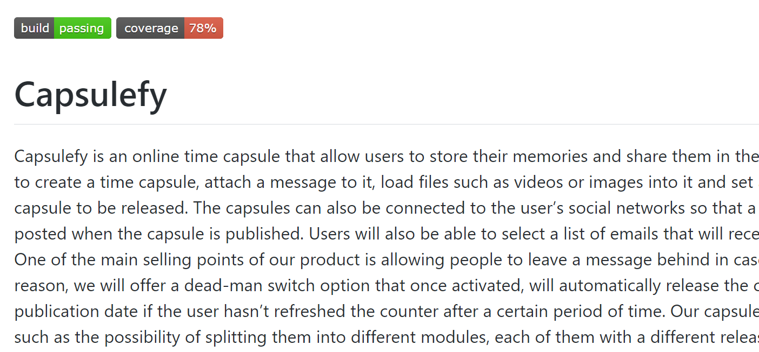

Slide 14

Release naming
1 | Devising a project
2 | Sprint 1
3 | Sprint 2
4 | Sprint 3
…
Release X
X =

Slide 15
URL naming
1 | Landing page
2 | Sprint 1
3 | Sprint 2
4 | Sprint 3
capsulefy0X
.herokuapp.com
X =
capsulefy.herokuapp.com - Upstream

Slide 16
COMPETITORS
What makes us different?

Slide 17
 | Viajeros en el tiempo | Mytimecapsule | Miigen | thetimecapsule | Capsulefy
Automatic content publication
Free plan
Premium plan
Images
Videos
Social network integration
Deadman switch

Slide 18
COSTS
How much does Capsulefy cost?

Slide 19
Project duration | 4 months
Salaries | 20.80 €/hour
Hours per month | 40
Amortization | 60 months
Equipment | 306 €
Hosting (1 year) | 669 €
Advertising (6 months) | 3060 €
Customer support (1 year) | 15000 €
Risk prevention | 10% (2724 €)
Total | 44968 €

Slide 20



GDPR and measure calculation costs are included in the corresponding members’ salaries

Slide 21
GDPR
How do we comply with GDPR?

Slide 22

Users may delete their profile or capsules

Slide 23


Users can send an email to request unauthorized data deletion

Slide 24

Users will be prompted to reset their password if suspicious activity is detected

Slide 25


Users can send an email to retrieve all their stored data

Slide 26

All this information, including cookie usage, is available on our website

Slide 27


Users must agree to our terms of service before registering

Slide 28


What do we store?
Users:
- Full name
- Email
- Birthdate
- Notification email
- Social network token
Capsules:
- Content
- Files
- Emails
- Payment ID

Slide 29
TEAM
Who is behind?

Slide 30
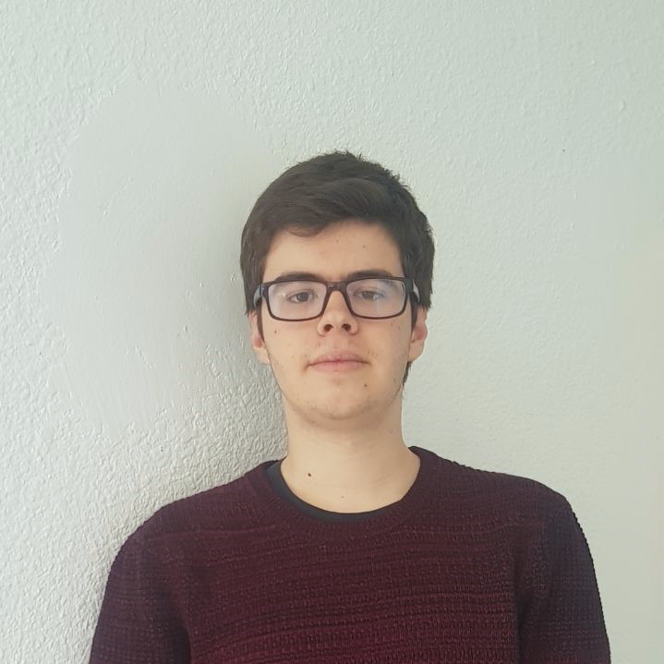
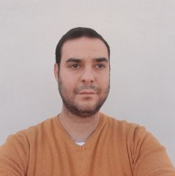




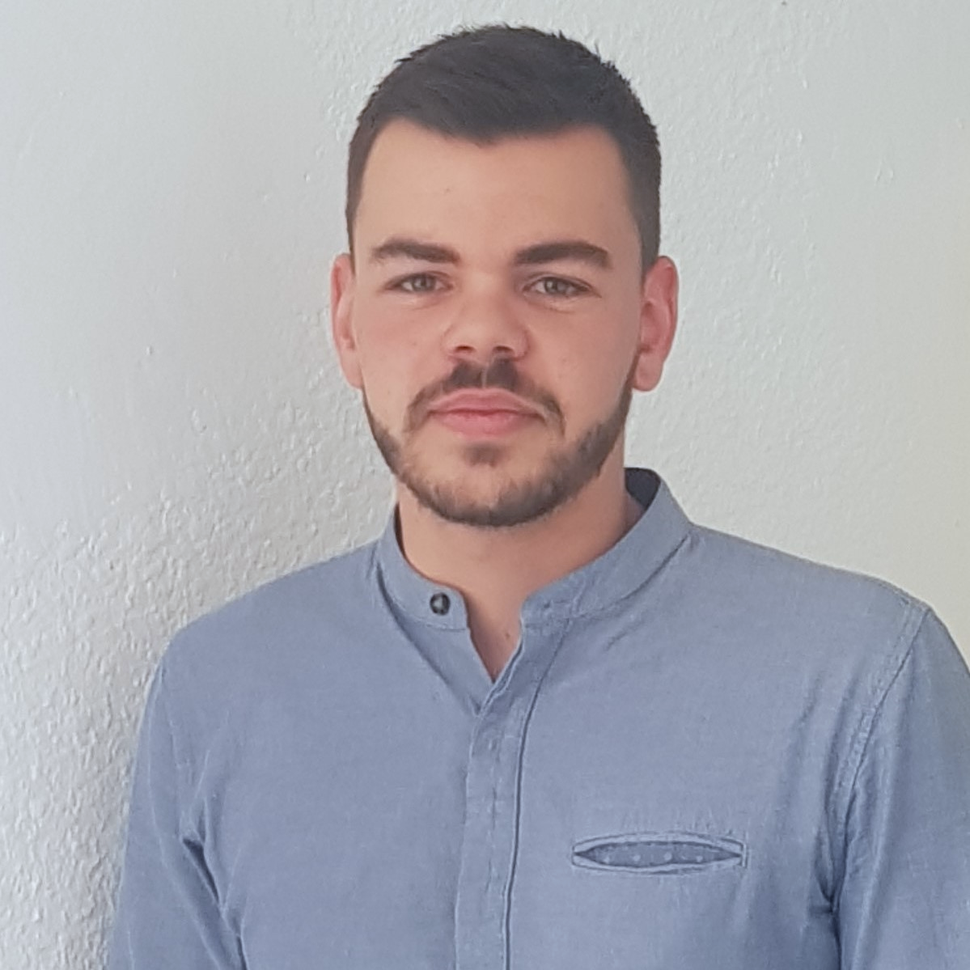
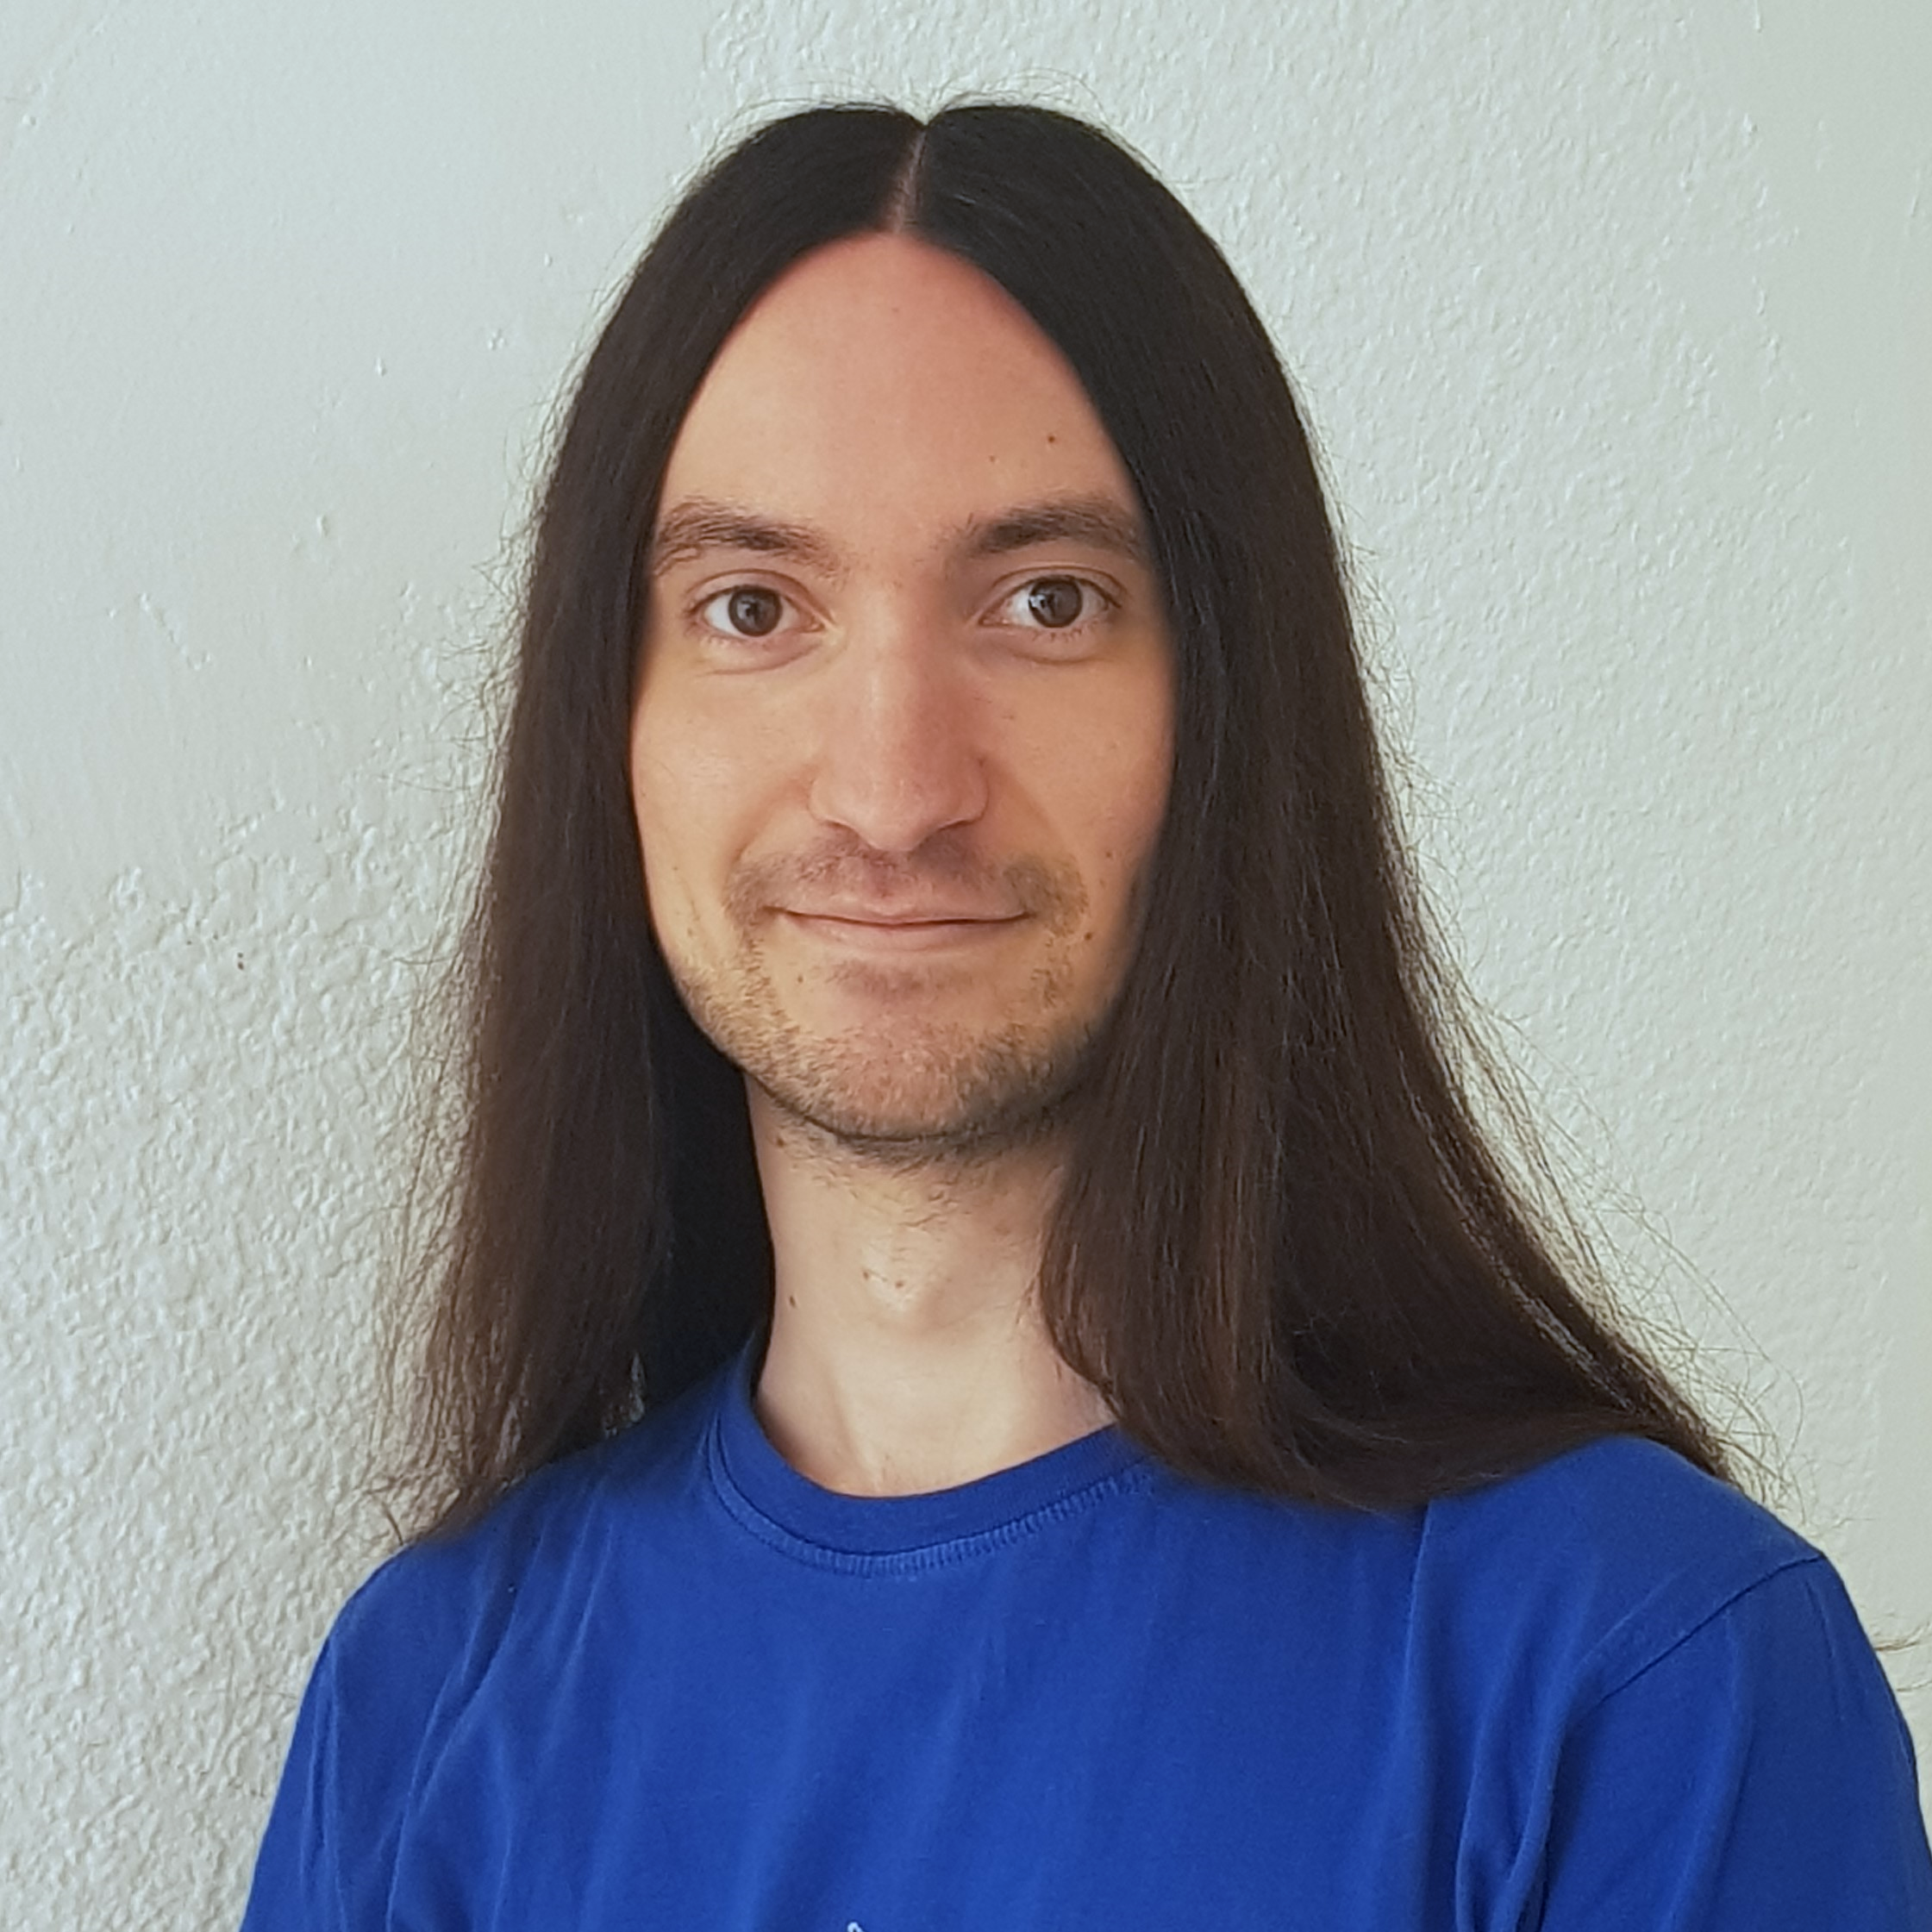


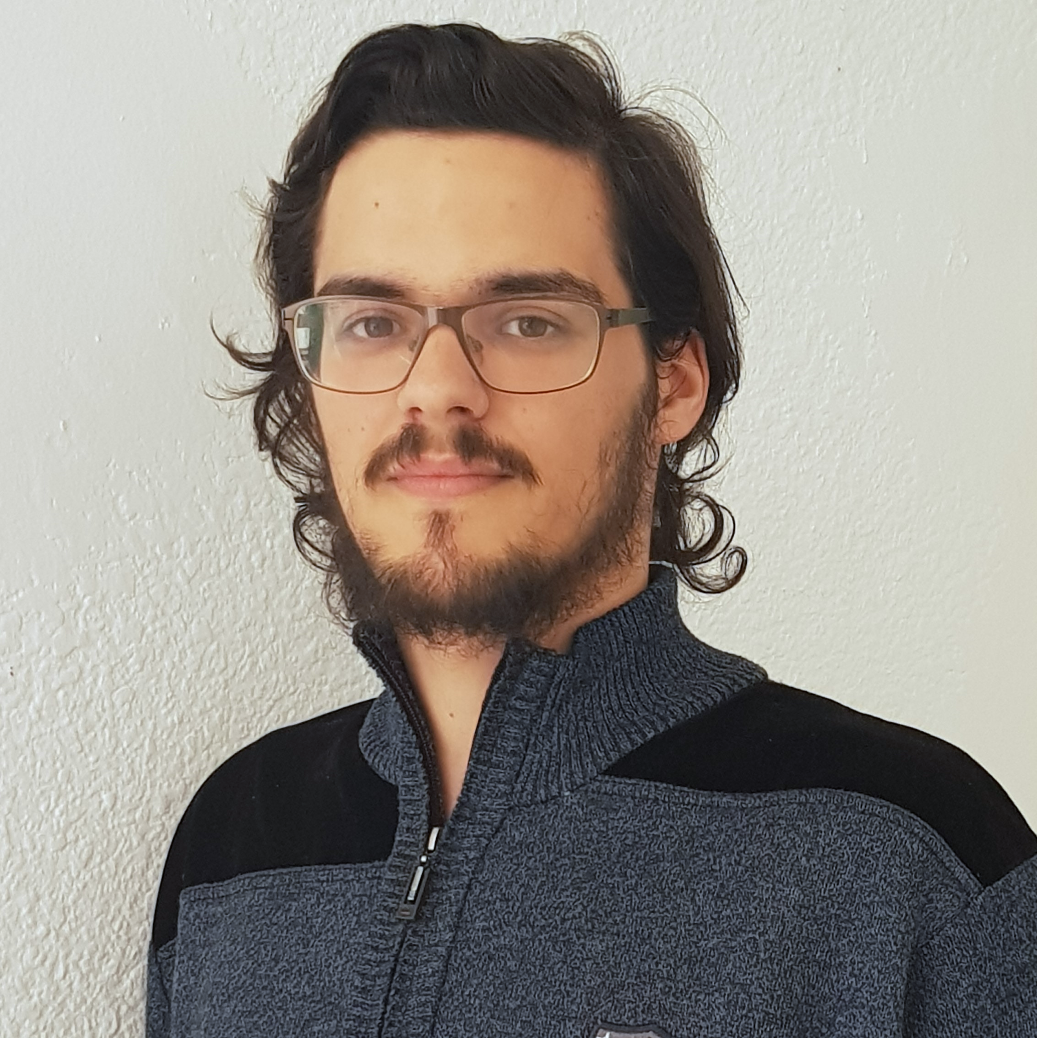



Pablo Rebollo
Project manager, backend developer
Juan Rodríguez
Requirements engineer, backend developer
Adrián Cantón
Business manager, full-stack developer
Rafael Fresno
Backend developer, API integration
Daniel Carpio
Analist,
frontend developer

Slide 31
PLANIFICATION
How do we organize development?

Slide 32
First sprint March 18th – March 29th | Core use cases Piloting plan
Second sprint April 1st – April 12th | Full MVP Feedback taken into account
Third sprint April 22nd – May 3rd | Polished MVP

Slide 33


Performance indicator
$$avg(\frac{Estimated time}{Invested time})$$
0.5
0.8
1.2
1.5
!
~
?

Slide 34
PM performance indicator
$$PMP∗avg\left(MP\right)−TD∗0.1$$
PMP: Project Manager performance
MP: Members performance
TD: Total task delays or
anticipations(days)
0.5
1.5
!
~
?

Slide 35

Relative performance indicator
$$\frac{avg(This week performance)}{avg(Last week performance)}$$
0.5
0.8
1.2
1.5
!
~
?

Slide 36



Factors affecting performance
Optimistic estimation
Wasted time
Difficulties
Pesimistic estimation
Easier tasks
Unknown technology

Slide 37



General solutions
Talk
Reschedule
Balance
Monitor

Slide 38
SPRINT 3 WEEK 1
April 22nd – April 28th

Slide 39
 |  | April
Task | Assignees | 22 | 23 | 24 | 25 | 26 | 27 | 28
Initial meeting | All
Improve checkboxes | Daniel
Coverage tests | Rafael
Unit tests | Adrián
Improve responsive | Daniel
Improve demo videos | Adrián
Add date picker | Juan
Fix sign up message | Juan

Slide 40
 |  | April
Task | Assignees | 22 | 23 | 24 | 25 | 26 | 27 | 28
Update costs | Pablo
GDPR | Pablo
Improve return button | Daniel
Improve 404 pages | Daniel
Improve email inputs | Daniel
Landing page content | Juan
Fix image proportions | Daniel
Test automation results | Pablo

Slide 41
 |  | April
Task | Assignees | 22 | 23 | 24 | 25 | 26 | 27 | 28
Improve dashboard | Juan
Review populate | Pablo
Presentation | Rafael
Advertisement video | Pablo
Rehearsal | Pablo

Slide 42
Performance
Pablo (PM) | 1.09
Daniel | 0.88
Rafael | 0.93
Adrián | 0.83
Juan | 1.1

Slide 43
Relative performance
This week | 0.96
Last week | 1.28
Result | 0.75

Slide 44
Project duration | 10 weeks (5 development)
Total salaries | 9797 €
Amortization | 60 months
Equipment | 265 €
Hosting and advertising | 0 €
Customer support | 15000 €
Risk prevention | 2724 €
Total | 27786 €
Project completion | 66 %
Spent budget | 61 %

Slide 45


What went wrong?
- What happened?
Two tasks had some delays.
- Solution
The PM will pay more
attention to task progress.
Task delays

Slide 46

What went wrong?
- Measure
Greatest delay in week 2 (days)
!
Task delays
2
3

Slide 47



What went wrong?
- What happened?
Creating a Facebook dev
account was not easy.
- Solution
Assign more people.
Facebook integration

Slide 48
What went wrong?
- Measure
Task completion in week 2 (%)
!
Facebook integration
50
75

Slide 49

Measures
Performance ratio
!
~
?
0.5
0.8
1.2
1.5
Divide tasks
W1 lowest performance: 0.83

Slide 50
Measures
Delay (days)
!
2
3
Divide tasks
W1 greatest delay: 1

Slide 51

Measures
Invested hours
!
6
7
Divide tasks
W1 task with most hours: 6

Slide 52

Measures
Invested days
!
6
7
Divide tasks
W1 task with most days: 4

Slide 53

Measures
Wiki entries
!
3
4
Better
tool usage
Wiki entries after W1: 6

Slide 54
SPRINT 3 WEEK 2
April 29th – May 3rd

Slide 55
 |  | April |  | May
Task | Assignees | 29 | 30 | 1 | 2 | 3
Feedback meeting | All
Update GDPR | Pablo
Facebook integration | Rafael
Fix nav header | Daniel
Capsule creation date | Daniel
Accept terms button | Juan
Name inconsistencies | Daniel
Remove unneeded links | Daniel

Slide 56
 |  | April |  | May
Task | Assignees | 29 | 30 | 1 | 2 | 3
Add favicon | Daniel
Password restriction | Juan
Password reset | Juan
Change email content | Juan
Add subtitles to ad | Pablo
Review populate | Pablo
Deploy app | Adrián
Record demo videos | Adrián

Slide 57
 |  | April |  | May
Task | Assignees | 29 | 30 | 1 | 2 | 3 | … | 12
Test app | Daniel, Juan
Presentation | Rafael
Sprint 3 doc | Pablo
StartUS tasks | Adrián
Rehearsal | Pablo

Slide 58
Performance
Pablo (PM) | 0.87
Daniel | 1.09
Rafael | 0.87
Adrián | 1
Juan | 0.99

Slide 59
Relative performance
This week | 0.96
Last week | 0.96
Result | 1

Slide 60
Project duration | 11 weeks (6 development)
Total salaries | 10484 €
Amortization | 60 months
Equipment | 292 €
Hosting and advertising | 0 €
Customer support | 15000 €
Risk prevention | 2724 €
Total | 28500 €
Project completion | 73 %
Spent budget | 63 %

Slide 61
Week 1 problems
- Measure
Greatest delay in week 2 (days)
!
Task delays
2
3
W2 greatest delay: 0

Slide 62
Week 1 problems
- Measure
Task completion in week 2 (%)
!
Facebook integration
50
75
Completion after W2: 40 %

Slide 63
Measures
Performance ratio
!
~
?
0.5
0.8
1.2
1.5
Divide tasks
W2 lowest performance: 0.87

Slide 64
Measures
Delay (days)
!
2
3
Divide tasks
W2 greatest delay: 0

Slide 65
Measures
Invested hours
!
6
7
Divide tasks
W2 task with most hours: 5

Slide 66
Measures
Invested days
!
6
7
Divide tasks
W2 task with most days: 3

Slide 67
Measures
Wiki entries
!
3
4
Better
tool usage
Wiki entries after W2: 7

Slide 68
Lessons learnt
Failed Facebook integration
Allocate more resources

Slide 69


Lessons learnt
Early deployment
Many bugs were detected

Slide 70

Lessons learnt
Some pilot user delays
Personally talk to them

Slide 71
SPRINT 3 RESULTS
What was produced?

Slide 72
Documentation
Sprint 3 documentation
Updated user manual and pilot users form
Development
Frozen app: https://capsulefy04.herokuapp.com
GitHub release: https://github.com/pabreblob/capsulefy/releases

Slide 73
DEMO
How does the system look like?

Slide 74
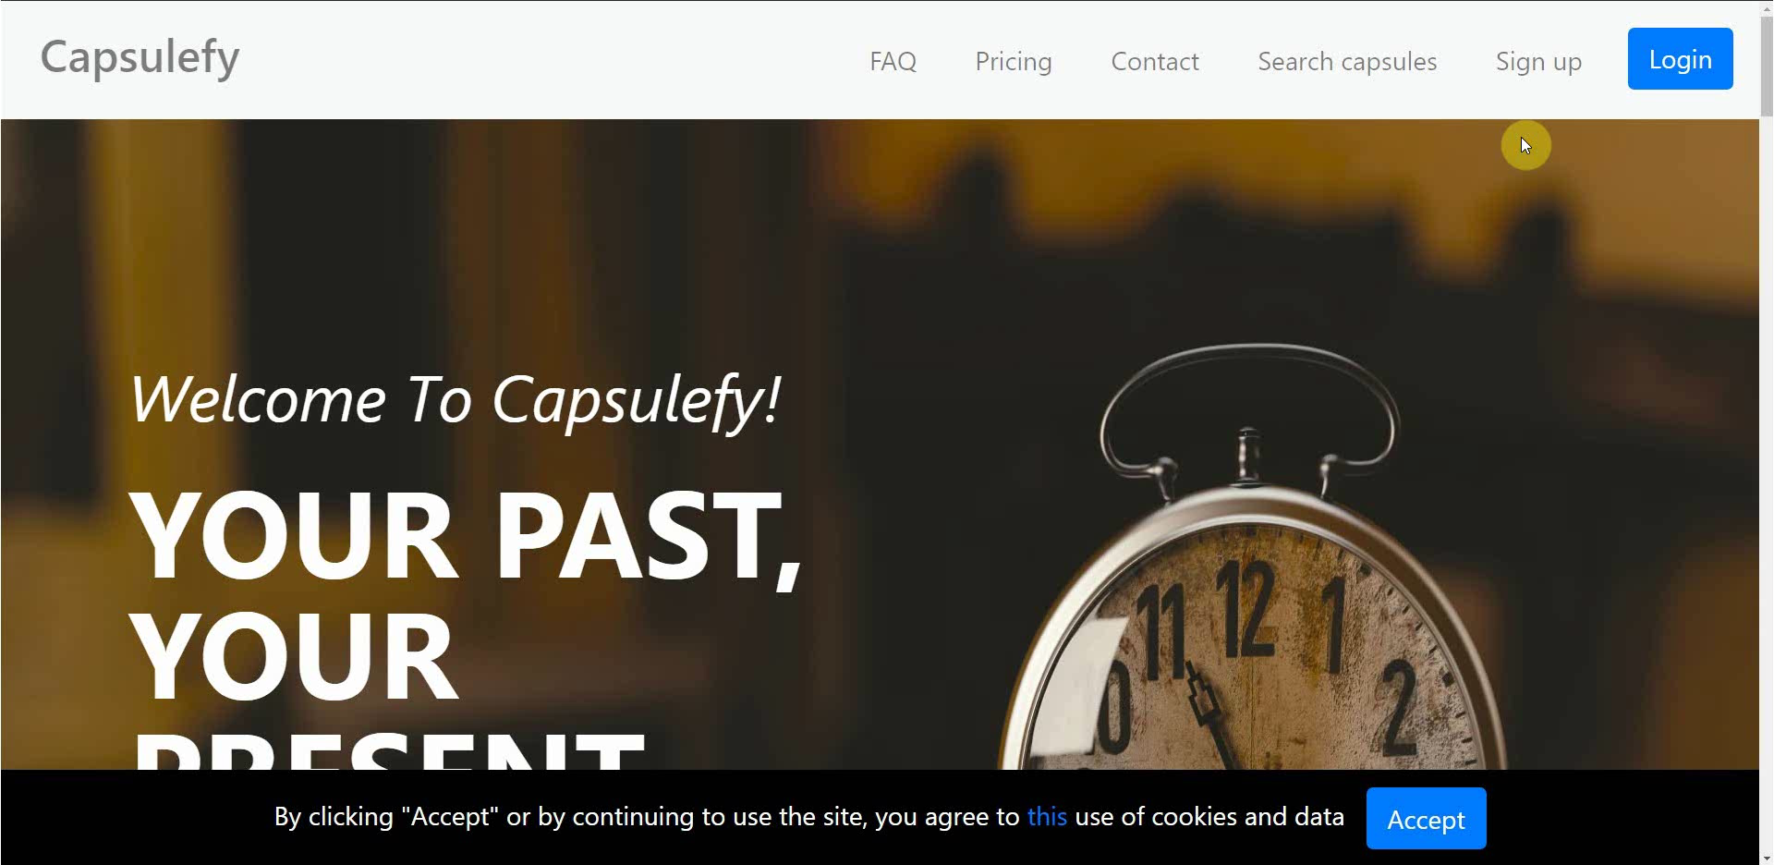
No logged user – Sign up

Slide 75
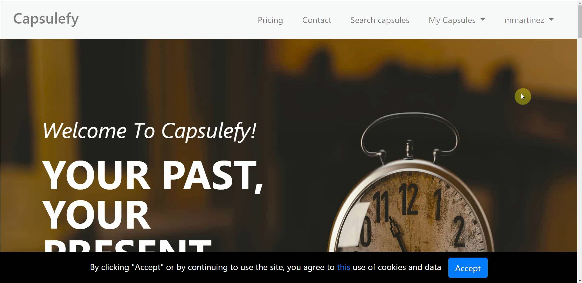
Logged-in user – Change password

Slide 76
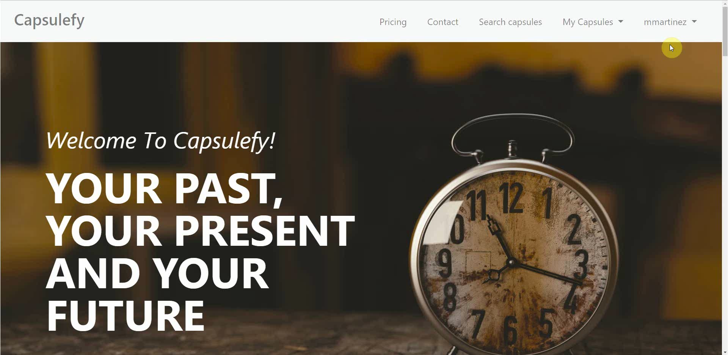
Logged-in user – Connect to Twitter

Slide 77

Logged-in user – Create and display capsule

Slide 78

Logged-in user – Refresh timer

Slide 79

Logged-in user – Delete account

Slide 80
Project launch Week 1
May 13th – May 19th

Slide 81
 |  | May
Task | Assignees | 13 | 14 | 15 | 16 | 17 | 18 | 19
Initial meeting | All
Facebook integration | Rafael
New ad spot | Daniel
Social network ads | Juan
Final costs and pricing | Pablo
Discount campaign | Juan
StartUS tasks | Adrián
Review populate | Pablo

Slide 82
 |  | May
Task | Assignees | 13 | 14 | 15 | 16 | 17 | 18 | 19
Deploy app | Adrián
Presentation | Rafael
Rehearsal | Pablo

Slide 83
Project launch Week 2
May 20th – May 24th

Slide 84
 |  | May
Task | Assignees | 20 | 21 | 22 | 23 | 24 | 25 | 26
Feedback meeting | All
Improve ad spot | Rafael
Improve frontend | Daniel
Improve core use cases | Juan
Create posters | Pablo
StartUS tasks | Adrián
Deploy app | Adrián

Slide 85
 |  | May
Task | Assignees | 20 | 21 | 22 | 23 | 24 | 25 | 26
Test app | Daniel, Juan
Presentation | Rafael
Project launch doc | Pablo
Rehearsal | Pablo

Slide 86
PILOTING PLAN
How will users test Capsulefy?

Slide 87
Create manual
Create test suite
Test the system
Gather feedback
Fill form

Slide 88
Committed users
Name | Age
Francisco R. | 55
Javier A. | 19
Valentin A. | 19
Antonio G. | 26
José Manuel J. | 21
Name | Age
Sandra C. | 28
José Manuel C. | 21
Rafael C. | 55
Antonio C. | 54
Auxiliadora L. | 50

Slide 89
Sprint 2
Users receive and fill form
March 30 – April 6
Development
April 8 – April 12
Receive users feedback
April 6
Planification
April 8

Slide 90
Sprint 3
Easter Week
Users receive and fill form
April 12 – April 22
Development
April 22 – May 3
Receive users feedback
April 22
Planification
April 22

Slide 91
second FEEDBACK RESULTS
What did users say?

Slide 92

Priority ranking
Depending on core use cases impact:
- High: assert functionality
- Medium: ease of use
- Low: look and feel improvements

Slide 93

“It would be interesting to see the creation and publication dates”

Slide 94

Frontend improvements
Solution
Status
Add creation date
Done
During sprint 3, week 2
Priority: low

Slide 95
“Passwords should require a minimum length and some special characters”

Slide 96
Password validation
Solution
Status
Add password restrictions
Done
During sprint 3, week 2
***
Priority: medium

Slide 97
“It would be nice to be able to share capsules in Facebook”

Slide 98

Facebook integration
Solution
Status
Add Facebook integration
To be determined
Due to several difficulties
?
Priority: high

Slide 99
“When registering, a date picker for the birthdate would be appreciated”

Slide 100
Frontend improvements
Solution
Status
Add date picker for birthdate
Done
During sprint 3, week 1
Priority: medium

Slide 101
“There is no favicon and some contextual help would be great”

Slide 102

Frontend improvements
Solution
Status
Add favicon and more helpful icons
Done
During sprint 3, week 2
Priority: low

Slide 103
“Some names are different when creating and displaying capsules”

Slide 104
Frontend improvements
Solution
Status
Review and fix inconsistent names
Done
During sprint 3, week 2
abc
Priority: medium

Slide 105
After development
Users receive and fill form
May 4 – May 12
Receive users feedback
May 12
Planification
May 13

Slide 106
Documentation
Manual (PDF)
Test suite
Form
https://forms.gle/NjECqguaiS1hMcSW9

Slide 107
Thanks!
Upstream: https://capsulefy.herokuapp.com
Sprint 3: https://capsulefy04.herokuapp.com
Landing page: https://capsulefy01.herokuapp.com
Contact email: capsulefy.communications@gmail.com
Pilot users form: https://forms.gle/https://forms.gle/NjECqguaiS1hMcSW9
GitHub releases: https://github.com/pabreblob/capsulefy/releases

Slide 108


Deadman switch
ON

Slide 109




Teamwork
Skills
Profitable work
Positive feedback

Slide 110


Realistic | 44968 – 46330 €
Optimistic | 43061 €
Pesimistic | 49054 €
Project duration: 4 months

Slide 111

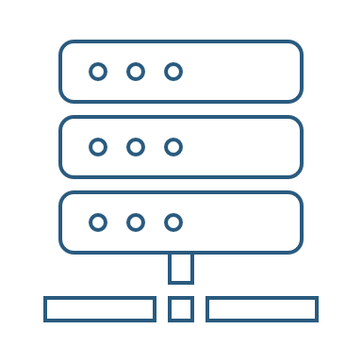

Risk | Mitigation
Broken computer | Risk prevention funds
Changing terms of use | Monitor
Servers down | Monitor
Incompatible timetables | Reschedule

Slide 112
Year 1: 2000 sales
Balance: -25168 €
Year 2: 4000 sales
Balance: 11441 €
44968 €
39600 €
28159 €
19800 €
Costs
Earnings
Costs
Earnings

Slide 113
Year 3: 8000 sales
Balance: 36450 €
79200 €
29023 €
Costs
Earnings

Slide 114

Monthly advertising costs
220 €
140 €
150 €

Slide 115
SPRINT 1 WEEK 1
March 18th – March 22nd

Slide 116
Task | Assignees | Est. (h) | Inv. (h) | Status
Data model | Adrián, Daniel | 4 | 1.5 | Finished
Set up environment | All | 2.5 | 2.5 | Finished
Angular research | Daniel | 1 | 2 | Aborted
Data model implementation | Juan | 2.5 | 2 | Finished
Populate database | Pablo | 2 | 3.2 | Finished
Basic capsule CRUD | Rafael | 2.5 | 9 | To be tested
Display capsules | Adrián | 2 | 5 | To be tested
TIME

Slide 117
Task | Assignees | Est. (h) | Inv. (h) | Status
Listing capsules | Juan | 1.5 | 1 | To be tested
User login | Juan | 1 | 1 | To be tested
Advertisement budget | Pablo | 1.5 | 1.5 | Finished
User interface | Daniel | 1 | 10 | Finished
Documentation | Daniel, Adrián, Juan | 1.5 | 1.5 | Finished
Presentation | Pablo, Rafael | 3 | 4 | Finished
Review meeting | All | 2.5 | 2.5 | Finished
TIME

Slide 118
Performance
Adrián | 1.34
Daniel | 1.05
Rafael | 0.67
Pablo | 0.84
Juan | 1.06

Slide 119


What went wrong?
No Angular knowledge
Bad estimations
Lack of time

Slide 120
SPRINT 1 WEEK 2
March 25th – March 29th

Slide 121
Task | Assignees | Est. (h) | Inv. (h) | Status
Feedback meeting | All | 5 | 5 | Finished
Travis CI set up | Adrián, Rafael | 2 | 3 | Finished
Modular capsules | Adrián | 5 | 4.5 | Finished
Private capsules | Juan | 2 | 1.5 | Finished
Email automation | Juan | 2 | 1.5 | Finished
Search capsules | Daniel | 1.5 | 1 | Finished
List own capsules | Juan | 1 | 1 | Finished
Pagination | Juan | 1 | 3 | Finished
TIME

Slide 122
Task | Assignees | Est. (h) | Inv. (h) | Status
Deadman switch | Pablo | 4 | 5 | Finished
Social network integration | Rafael | 4 | 1 | Postponed
User interface | Daniel | 4 | 7 | Finished
Piloting plan | Adrián | 2.5 | 1 | Finished
Sprint meeting | All | 5 | 5 | Finished
Documentation | Adrián, Daniel, Juan | 1.5 | 1.5 | Finished
Presentation | Rafael | 3 | 5.5 | Finished
Deliverable | Pablo | 3 | 4 | Finished
TIME

Slide 123
Performance
Adrián | 1.32
Daniel | 1.03
Rafael | 0.60
Pablo | 0.77
Juan | 0.87

Slide 124
What went wrong?
Performance further reduced
Implementation differences
Lack of time

Slide 125
What actions were taken?
Meet
Reschedule
Reestimate

Slide 126
Total performance
Adrián | 1.31
Daniel | 1.02
Rafael | 0.63
Pablo | 0.80
Juan | 0.96

Slide 127

Taken actions
Detailed planning
Time for documentation
Better tool usage
Divide tasks

Slide 128
SPRINT 1 RESULTS
What was produced?

Slide 129
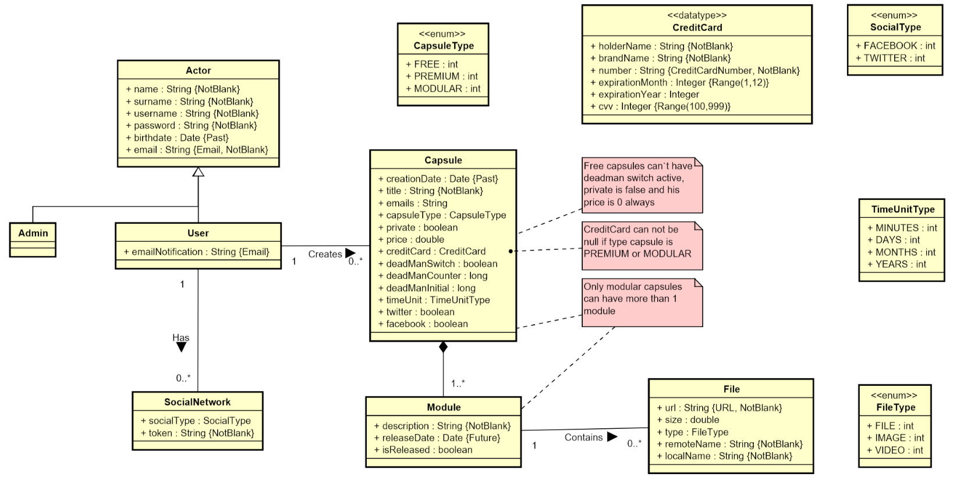

Slide 130
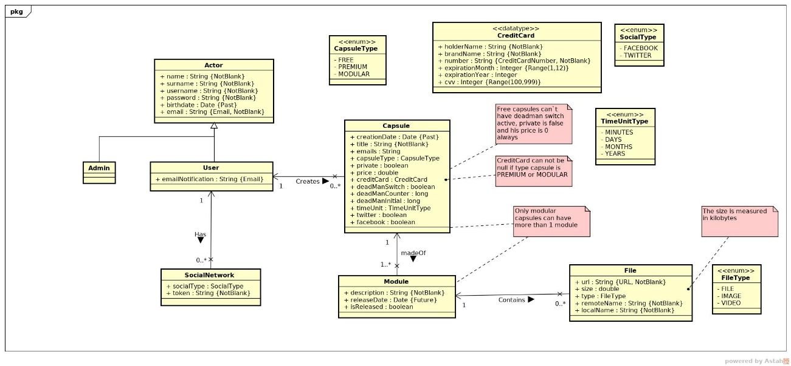

Slide 131
Documentation
Sprint 1 documentation
Piloting plan
Development
Frozen app: https://capsulefy02.herokuapp.com
GitHub release: https://github.com/pabreblob/capsulefy/releases

Slide 132
Project duration | 7 weeks (2 development)
Salaries | 20.80 €/hour
Hours per month | 40
Total salaries | 6989 €
Amortization | 60 months
Equipment | 134.16 €
Hosting | 0 €
Advertising | 0 €
Total | 7123.16 €

Slide 133
Quality (p) | MB/minute
144 | 1.3
240 | 3.3
360 | 5
480 | 8.3
720 | 25
1080 | 50

Slide 134
SPRINT 2 WEEK 1
April 1st – April 7th

Slide 135
 |  | April
Task | Assignees | 1 | 2 | 3 | 4 | 5 | 6 | 7
Initial meeting | All
Local settings | Daniel
User registration | Juan
Remove expired capsules | Pablo
Twitter integration | Rafael
Update modular form | Adrián
Fix pagination issues | Juan
DM email notifications | Pablo

Slide 136
 |  | April
Task | Assignees | 1 | 2 | 3 | 4 | 5 | 6 | 7
UI: Registration | Daniel
Ban users | Juan
UI: User account | Daniel
Automations | Pablo
Basic payment | Adrián
Presentation | Rafael
UI: List and search users | Daniel
Rehearsal | Pablo

Slide 137
Unplanned tasks
Task | Assignees | Invested time (h)
Travis test problems | Daniel | 1.5
Check DM switch when editing capsules | Daniel | 0.25
Fix AJAX search | Juan | 0.5
Add tooltip for notification emails | Daniel | 1
Improve registration form | Juan | 2

Slide 138
Performance
Pablo (PM) | 0.93
Daniel | 1.44
Rafael | 1
Adrián | 0.94
Juan | 1.08

Slide 139
Sprint 1 problem
Bad estimations
Solution:
Divide tasks

Slide 140
Measures
Performance ratio
!
~
?
0.5
0.8
1.2
1.5
Divide tasks
W1 lowest performance: 0.93

Slide 141

Measures
Delay (days)
2
Divide tasks
W1 greatest delay: 2

Slide 142
Measures
Invested hours
6
Divide tasks
W1 task with most hours: 6

Slide 143
Measures
Invested days
6
Divide tasks
W1 task with most days: 5

Slide 144
Sprint 1 problem
Poor tool usage
Solution:
Better tool usage

Slide 145
Measures
Wiki entries
~4
Better
tool usage
Wiki entries after W1: 5

Slide 146
What went wrong?
- What happened?
Django 2.2 broke our tests.
- Solution
Migrate to Django 2.2 and fix
all tests.
Django update

Slide 147
What went wrong?
- Measure
Number of failing tests
Django update
0
Number after W1: 0

Slide 148

What went wrong?
- What happened?
Late deployment led to many
errors.
- Solution
Deploy 2 days before deadline.
Deployment
problems

Slide 149
What went wrong?
- Measure
Days before deadline
Deployment
problems
2
Days in W1: 0

Slide 150
Project duration | 8 weeks (3 development)
Salaries | 20.80 €/hour
Hours per month | 40
Total salaries | 8207 €
Amortization | 60 months
Equipment | 200 €
Hosting | 0 €
Advertising | 0 €
Total | 8407 €

Slide 151
Task | Assign. | Start | End | Est. (h) | Inv. (h)
Initial meeting | All | Apr 1 | Apr 1 | 1.5 | 1.5
Local settings | Daniel | Apr 2 | Apr 2 | 1 | 0.5
User registration | Juan | Apr 2 | Apr 2 | 2 | 2
Remove expired capsules | Pablo | Apr 2 | Apr 2 | 1.5 | 1.5
Twitter integration | Rafael | Apr 2 | Apr 4 | 4 | 4
Update modular form | Adrián | Apr 2 | Apr 3 | 5 | 6
Fix pagination issues | Juan | Apr 3 | Apr 3 | 1.5 | 1.5
DM switch notifications | Pablo | Apr 3 | Apr 4 | 1.5 | 2
UI: Registration | Daniel | Apr 3 | Apr 4 | 0.5 | 0.25
TIME

Slide 152
Task | Assign. | Start | End | Est. (h) | Inv. (h)
Ban users | Juan | Apr 4 | Apr 6 | 2 | 1.5
UI: User account | Daniel | Apr 4 | Apr 6 | 1.5 | 1.25
Automation improvements | Pablo | Apr 4 | Apr 7 | 4 | 4.5
Basic payment | Adrián | Apr 5 | Apr 7 | 4 | 4
Presentation | Rafael | Apr 5 | Apr 7 | 3 | 3
UI: List and search users | Daniel | Apr 6 | Apr 7 | 2 | 2
Rehearsal | Pablo | Apr 7 | Apr 7 | 1.5 | 1
TIME

Slide 153
SPRINT 2 WEEK 2
April 8th – April 12th

Slide 154
 |  | April
Task | Assignees | 8 | 9 | 10 | 11 | 12
Feedback meeting | All
Fix functional tests | Adrián
Admin dashboard | Juan
Delete user data | Pablo
Add date picker | Adrián
Fix notification emails | Daniel
Add confirmation button | Daniel
Edit notifications emails | Rafael

Slide 155
 |  | April
Task | Assignees | 8 | 9 | 10 | 11 | 12
“About us” page | Daniel
Add return button | Daniel
Fix frontend errors | Daniel
Deploy app | Adrián
Test app | Daniel, Juan
Presentation | Rafael
Pilot users form | Pablo
User manual | Pablo

Slide 156
 |  | April
Task | Assignees | 8 | 9 | 10 | 11 | 12 | 20 | 21
Sprint 2 retrospective doc | Pablo
Rehearsal | Pablo

Slide 157
Unplanned tasks
Task | Assignees | Invested time (h)
Update populate | Pablo | 0.5
Fix capsule edition URL | Adrián | 0.25

Slide 158
Performance
Pablo (PM) | 1.23
Daniel | 1.9
Rafael | 0.96
Adrián | 1.33
Juan | 1

Slide 159
Measures
Performance ratio
!
~
?
0.5
0.8
1.2
1.5
Divide tasks
W2 lowest performance: 0.96

Slide 160
Measures
Delay (days)
2
Divide tasks
W2 greatest delay: 0

Slide 161
Measures
Invested hours
6
Divide tasks
W2 task with most hours: 5.5

Slide 162
Measures
Invested days
6
Divide tasks
W2 task with most days: 5

Slide 163
Measures
Wiki entries
~4
Better
tool usage
Wiki entries after W2: 5

Slide 164
What went wrong?
- Measure
Days before deadline
Deployment
problems
2
Days in W2: 2

Slide 165

What went wrong?
No problems during week 2!

Slide 166

Why?
- No complex tasks
- No technical problems
- Main frontend already developed

Slide 167


Delayed tasks
- Facebook integration
- Performance tests
- SonarCloud set up

Slide 168
Lessons learnt
Software updates
Monitor and test

Slide 169
Lessons learnt
Late deployment
Earlier deployments

Slide 170
Lessons learnt
No piloting plan feedback
Earlier feedback discussion

Slide 171

Lessons learnt
Changes affecting data
Review populate script

Slide 172
Lessons learnt
Higher performance
Better estimations

Slide 173
Lessons learnt
Bug tracking
GitHub issues ratios

Slide 174
GitHub issues ratios
- Bugs over new features
Current ratio: 8/128=0.06
- Time invested on bugs over time invested on new features

Slide 175
Project duration | 9 weeks (4 development)
Salaries | 20.80 €/hour
Hours per month | 40
Total salaries | 9217 €
Amortization | 60 months
Equipment | 238 €
Hosting | 0 €
Advertising | 0 €
Total | 9455 €

Slide 176
SPRINT 2 RESULTS
What was produced?

Slide 177
Documentation
Sprint 2 documentation
Updated user manual and pilot users form
Development
Frozen app: https://capsulefy03.herokuapp.com
GitHub release: https://github.com/pabreblob/capsulefy/releases

Slide 178
Task | Assign. | Start | End | Est. (h) | Inv. (h)
Feedback meeting | All | Apr 8 | Apr 8 | 1.5 | 1.5
Fix functional tests | Adrián | Apr 8 | Apr 10 | 0.75 | 0.5
Admin dashboard | Juan | Apr 8 | Apr 10 | 3 | 3
Delete user data | Pablo | Apr 8 | Apr 10 | 1.5 | 2
Add date picker | Adrián | Apr 8 | Apr 10 | 1 | 1
Fix notification emails | Daniel | Apr 8 | Apr 10 | 0.5 | 0.2
Add confirm button | Daniel | Apr 8 | Apr 10 | 1 | 0.4
Edit notification email | Rafael | Apr 8 | Apr 10 | 1 | 1
TIME

Slide 179
Task | Assign. | Start | End | Est. (h) | Inv. (h)
“About us” page | Daniel | Apr 8 | Apr 10 | 0.25 | 0.25
Add return button | Daniel | Apr 8 | Apr 10 | 1 | 0.25
Fix frontend errors | Daniel | Apr 8 | Apr 10 | 1.5 | 1.5
Deploy app | Adrián | Apr 10 | Apr 10 | 2 | 1.5
Test app | Daniel, Juan | Apr 10 | Apr 12 | 2 | 2
Presentation | Rafael | Apr 10 | Apr 12 | 5 | 5.5
Pilot user form | Pablo | Apr 8 | Apr 12 | 1.5 | 2
User manual | Pablo | Apr 8 | Apr 12 | 1 | 0.75
TIME

Slide 180
Task | Assign. | Start | End | Est. (h) | Inv. (h)
Sprint 2 retrospective doc | Pablo | Apr 8 | Apr 12 | 4 | 4
Rehearsal | Pablo | Apr 20 | Apr 21 | 1.5 | -
TIME

Slide 181
SPRINT 3 WEEK 1
April 22th – April 28th

Slide 182
Task | Assign. | Start | End | Est. (h) | Inv. (h)
Initial meeting | All | Apr 22 | Apr 22 | 1.5 | 1.5
Improve checkboxes | Daniel | Apr 22 | Apr 22 | 2 | 1.75
Coverage tests | Rafael | Apr 23 | Apr 23 | 1 | 1
Unit tests | Adrián | Apr 23 | Apr 24 | 5 | 6
Improve responsive | Daniel | Apr 23 | Apr 26 | 1 | 1
Improve demo videos | Adrián | Apr 23 | Apr 25 | 1 | 1
Add date picker | Juan | Apr 23 | Apr 24 | 0.5 | 0.5
Fix sign up message | Juan | Apr 24 | Apr 25 | 0.5 | 0.5
TIME

Slide 183
Task | Assign. | Start | End | Est. (h) | Inv. (h)
Update costs | Pablo | Apr 24 | Apr 25 | 1.5 | 1
GDPR | Pablo | Apr 24 | Apr 24 | 2 | 1.5
Improve return button | Daniel | Apr 24 | Apr 25 | 0.5 | 0.75
Improve 404 pages | Daniel | Apr 24 | Apr 25 | 0.5 | 0.5
Improve email inputs | Daniel | Apr 24 | Apr 24 | 1 | 1.25
Landing page content | Juan | Apr 24 | Apr 25 | 1.5 | 1
Fix image proportions | Daniel | Apr 24 | Apr 25 | 0.5 | 1
Test automation results | Pablo | Apr 25 | Apr 26 | 1.5 | 0.5
TIME

Slide 184
Task | Assign. | Start | End | Est. (h) | Inv. (h)
Improve dashboard | Juan | Apr 25 | Apr 26 | 2 | 2
Review populate | Pablo | Apr 25 | Apr 25 | 1 | 0.75
Presentation | Rafael | Apr 26 | Apr 28 | 3 | 3.5
Advertisement video | Pablo | Apr 27 | Apr 28 | 2 | 2
Rehearsal | Pablo | Apr 28 | Apr 28 | 1 | 1
TIME

Slide 185
SPRINT 3 WEEK 2
April 29th – May 3rd

Slide 186
Task | Assign. | Start | End | Est. (h) | Inv. (h)
Feedback meeting | All | Apr 29 | Apr 29 | 1.5 | 1.5
Update GDPR | Pablo | Apr 29 | Apr 29 | 0.5 | 0.5
Facebook integration | Rafael | Apr 29 | May 1 | 5 | 4.5
Fix nav header | Daniel | Apr 29 | May 1 | 1.5 | 1
Capsule creation date | Daniel | Apr 29 | May 1 | 1.5 | 1
Accept terms button | Juan | Apr 29 | May 1 | 1.5 | 1
Name inconsistencies | Daniel | Apr 29 | May 1 | 1.5 | 1.5
Remove unneeded links | Daniel | Apr 29 | May 1 | 0.5 | 0.5
TIME

Slide 187
Task | Assign. | Start | End | Est. (h) | Inv. (h)
Add favicon | Daniel | Apr 29 | May 1 | 0.5 | 0.5
Password restriction | Juan | Apr 29 | May 1 | 2 | 1.5
Password reset | Juan | Apr 29 | May 1 | 2 | 2
Change email content | Juan | Apr 29 | May 1 | 0.5 | 1
Add subtitles to ad | Pablo | Apr 30 | May 2 | 1 | 1.5
Review populate | Pablo | May 1 | May 1 | 0.5 | 0.5
Deploy app | Adrián | May 1 | May 1 | 1.5 | 1.5
Record demo videos | Adrián | May 1 | May 2 | 3 | 3
TIME

Slide 188
Task | Assign. | Start | End | Est. (h) | Inv. (h)
Test app | Daniel, Juan | May 2 | May 3 | 4 | 6
Presentation | Rafael | May 2 | May 3 | 3 | 4
Sprint 3 doc | Pablo | May 1 | May 3 | 4 | 5
StartUS tasks | Adrián | May 1 | May 12 | 2 | -
Rehearsal | Pablo | May 12 | May 12 | 1.5 | -
TIME

Slide 189
Testing
Functional and integration
Performance
Coverage

Slide 190
Project launch Week 1
May 13th – May 19th

Slide 191
Task | Assign. | Start | End | Est. (h) | Inv. (h)
Initial meeting | All | May 13 | May 13 | 1.5 | -
Facebook integration | Rafael | May 13 | May 17 | 5 | -
New ad spot | Daniel | May 13 | May 16 | 4 | -
Social network ads | Juan | May 13 | May 16 | 3 | -
Final costs and pricing | Pablo | May 13 | May 16 | 1.5 | -
Discount campaign | Juan | May 13 | May 16 | 1.5 | -
StartUS tasks | Adrián | May 14 | May 16 | 2 | -
Review populate | Pablo | May 15 | May 16 | 1 | -
TIME

Slide 192
Task | Assign. | Start | End | Est. (h) | Inv. (h)
Deploy app | Adrián | May 17 | May 17 | 1.5 | -
Presentation | Rafael | May 17 | May 19 | 3 | -
Rehearsal | Pablo | May 19 | May 19 | 1 | -
TIME

Slide 193
Project launch Week 2
May 20th – May 24th

Slide 194
Task | Assign. | Start | End | Est. (h) | Inv. (h)
Feedback meeting | All | May 20 | May 20 | 1.5 | -
Improve ad spot | Rafael | May 20 | May 22 | 2 | -
Improve frontend | Daniel | May 20 | May 22 | 2 | -
Improve core use cases | Juan | May 20 | May 22 | 3 | -
Create posters | Pablo | May 22 | May 23 | 2 | -
StartUS tasks | Adrián | May 21 | May 25 | 2 | -
Deploy app | Adrián | May 22 | May 22 | 1.5 | -
TIME

Slide 195
Task | Assign. | Start | End | Est. (h) | Inv. (h)
Test app | Daniel, Juan | May 22 | May 24 | 4 | -
Presentation | Rafael | May 21 | May 24 | 5 | -
Project launch doc | Pablo | May 22 | May 24 | 5 | -
Rehearsal | Pablo | May 26 | May 26 | 1.5 | -
TIME

